Slide 1
Jeffrey W. Holcomb

Slide 2
Instructor: Jeffrey W. Holcomb, Ph.D.
email: jholcomb@udallas.edu
Textbook: ``Introduction to Algorithms, (Third Edition)'' by T.H. Cormen, C.E. Leiserson, R.L. Rivest, and Clifford Stein.
Optional Text: The Algorithm Design Manual, Steven S. Skiena
Suggested Reading List: On Computable Numbers, with an Application to the Entscheidungsproblem, Alan Turing
Ueber eine elementare Frage der Mannigfaltigkeitslehre, Georg Cantor
Introduktion to Graph Theory, Gary Chartrand, Ping Zhang
Graph Theory, Frank Harary,
Computers and Intractability, A Guide to the Theory of NP-Completeness, Michael R. Garey, David S. Johnson
Introduction to the Theory of Computation, 2nd Edition, Michael Sipser

Slide 3
Instructor: Jeffrey W. Holcomb
Course Objectives:
Ability to understand asymptotic notations, recurrences, algorithm analysis
Ability to understand divide and conquer algorithms
Ability to understand greedy algorithms
Ability to understand dynamic programming algorithms
Ability to understand graph algorithms, flow networks
Ability to understand NP-Completeness
Topics: Recurrence relations, Order notation. Divide and conquer, greedy methods, lower bounds, dynamic programming, linear programming, and inductive algorithms. Graph algorithms: Search techniques: DFS and BFS, Minimum spanning trees, Shortest path problems, Maximum flow problems, Matching, NP-completeness, Reductions.
Grades: Assignments 10%; Exam 1 (35%); Exam 2 (35%) ; Class Project (20%)

Slide 4
Class Project
Implement a Fractal method utilizing python and render the result performing python.
Be able to present the rendered fractal by midterms
Be able to perform at least one advanced operation upon the fractal by finals
Your development is to be done in Visual Studios:
https://www.visualstudio.com/

Slide 5
Class Project
Your are required to program in python:
https://www.python.org/downloads/
Note: Visual Studio has a python extension!!!
To visualize your work, download and install the Panda3D game engine:
http://www.panda3d.org/

Slide 6
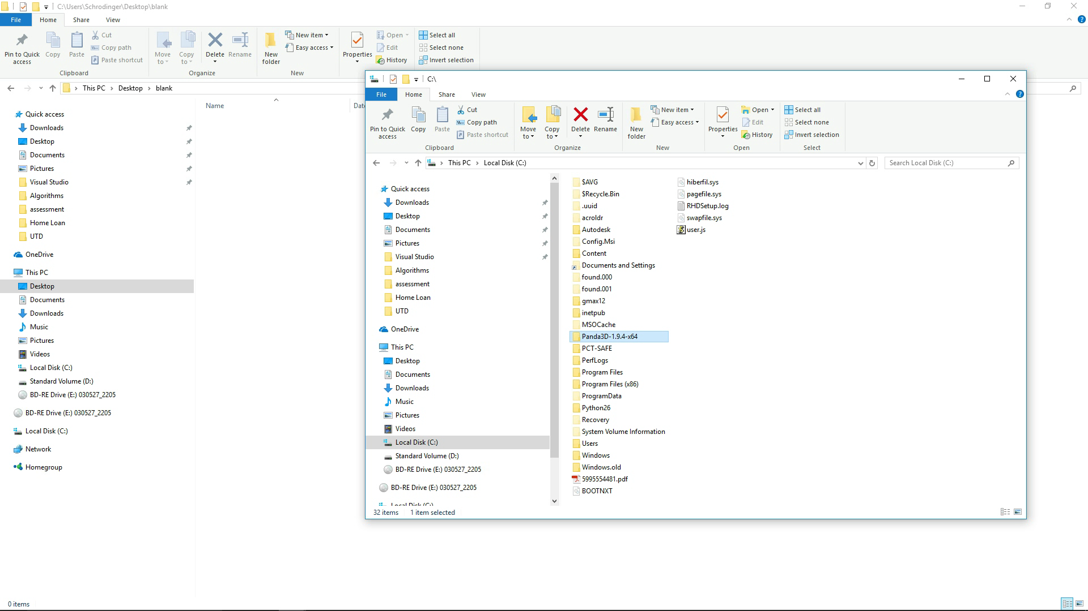
Class Project

Slide 7
Student Introductions:
Name
Year {freshman, sophomore, junior, senior}

Slide 8
Who am I?
Name: Jeffrey W. Holcomb, Ph.D.
Employer: Lockheed Martin
Job: I am an algorithms engineers for Lockheed Martin out at the Fort Worth campus.
Research Interests: computational geometry, complexity theory, quantum logic, game theory, computer vision, computer animation, AI, etc

Slide 9
Uniquely UD
Who has heard of active and passive intellect (Plato)?
Passive Intellect:
That which provides the potential to understand
Mathematical formulations/data structures
Active Intellect:
That which performs the understanding
Algorithms/programs

Slide 10
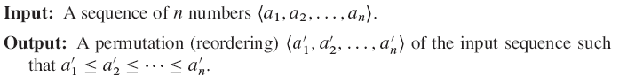
Introduction to Algorithms:
What is an Algorithm?
OBTAIN OBJECT DATA
80
COMPUTE MINIMAL REPRESENTATION
82
DERIVE MINIMAL REPRESENTATION
84
An algorithm is a step by step methodology for accomplishing a goal.
COMPUTE DEVIATION
86
IF DEVIATION LOW
88
false
true
RETUN FALSE
92
RETUN TRUE
90

Slide 11
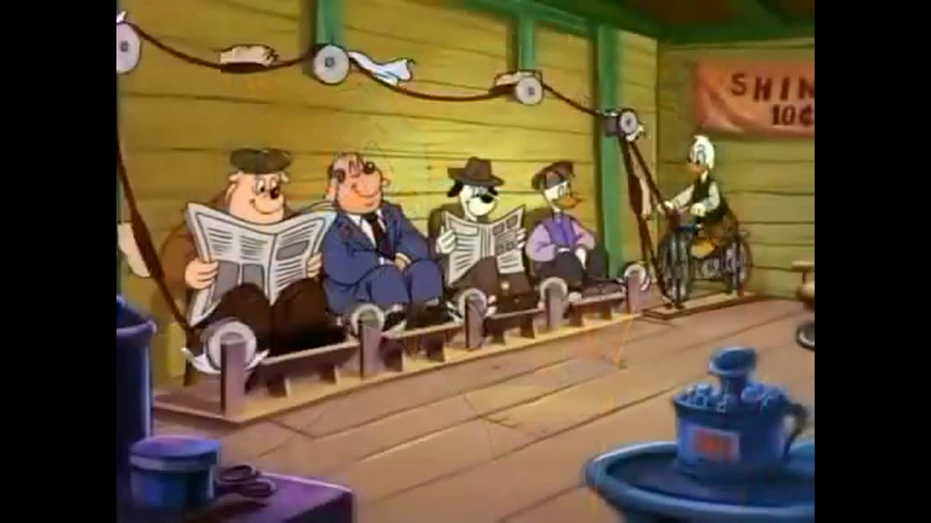
What is the purpose of algorithms engineering?
The purpose of algorithms engineering is to develop efficient algorithms
The efficiency of algorithms is measured in two ways: with respect to the efficiency of memory usage, and with respect to the use of time.

Slide 12
What can algorithms be used for?

Slide 13

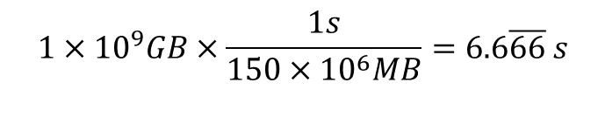
Let’s look at time efficiency
Given a 150 Mbps internet connect, how long will it take to download Visual Studios if VS is 1GB of information?
$$1×{10}^{9}GB×\frac{1s}{150×{10}^{6}MB}=6.6\overline{66} s$$

Slide 14
Growth of function

Slide 15
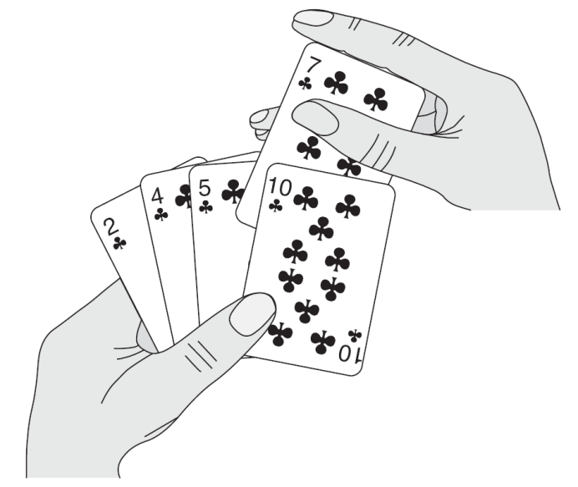
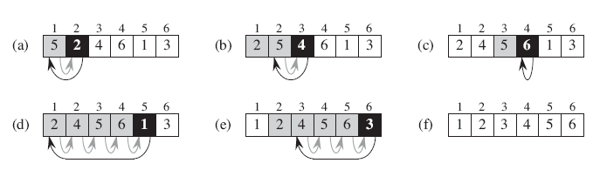
Insertion-Sort(A)

Slide 16
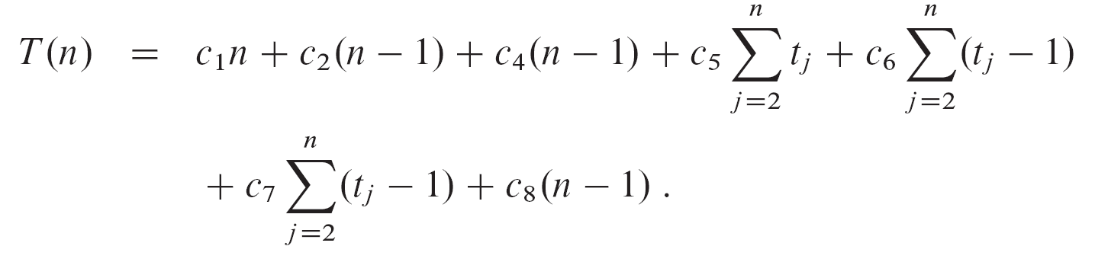

Slide 17
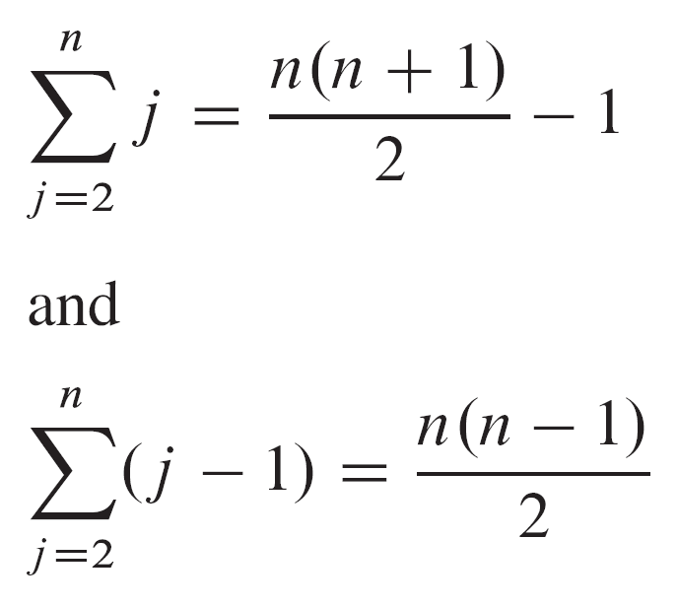

Slide 18
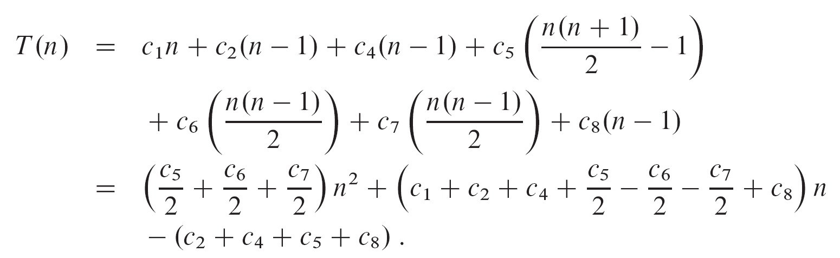

Slide 19
Order of growth

Slide 20
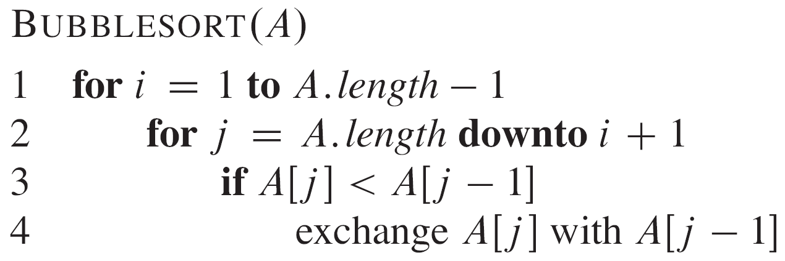
Bubblesort

Slide 21
Measuring Growth of Algorithms
time
memory

Slide 22
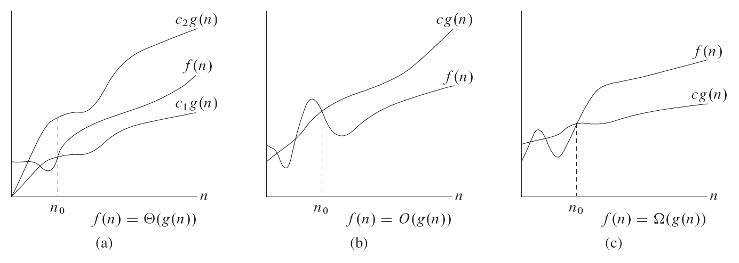

Slide 23
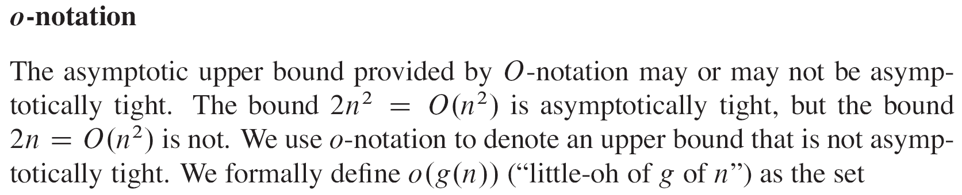
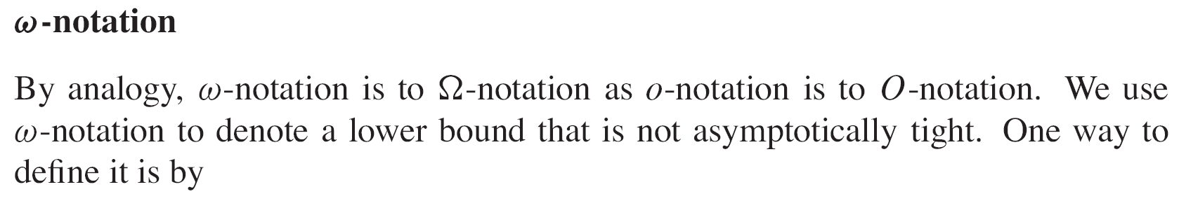
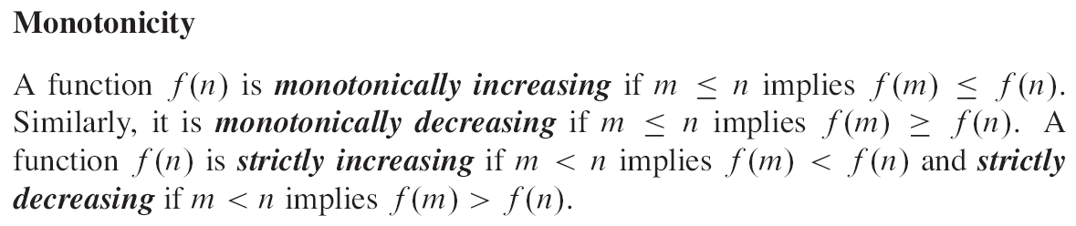
Measuring Growth of Algorithms: terminology

Slide 24
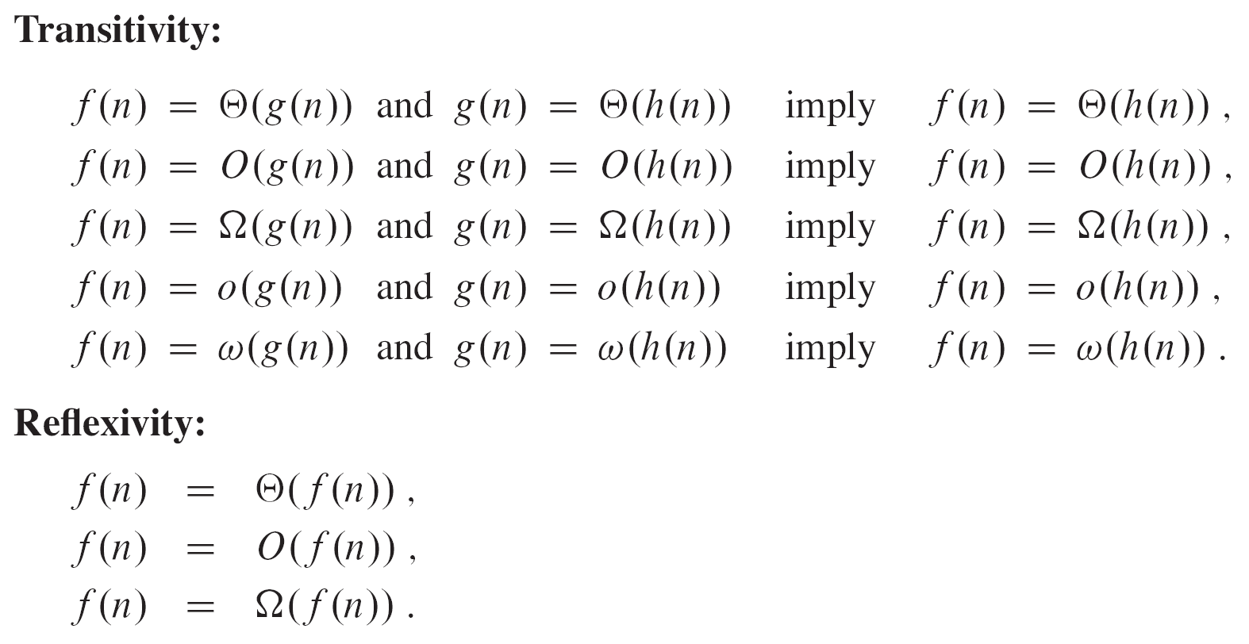
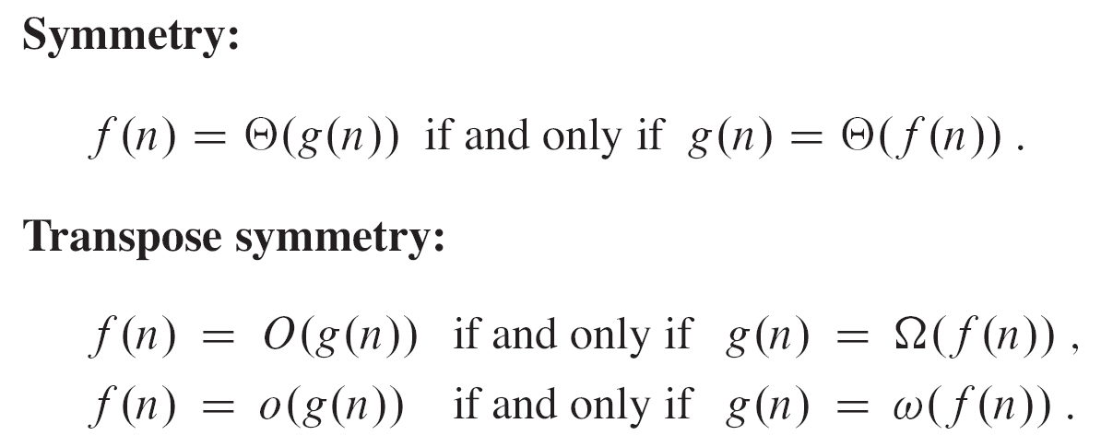
Measuring Growth of Algorithms: terminology

Slide 25
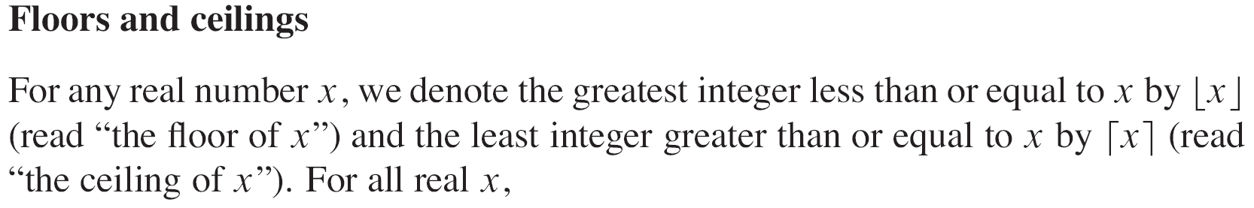
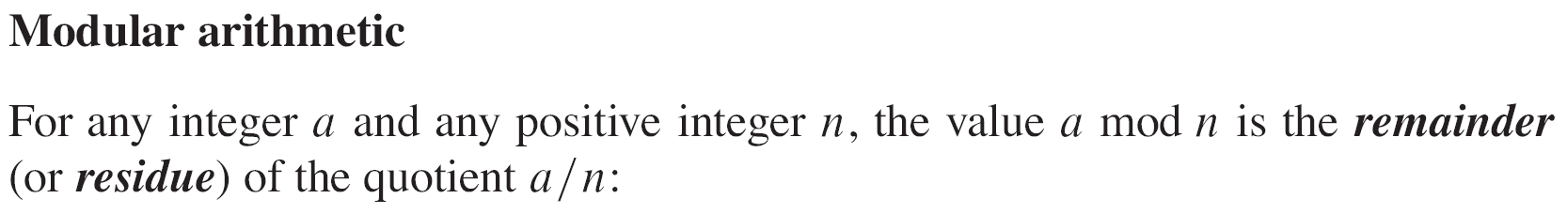
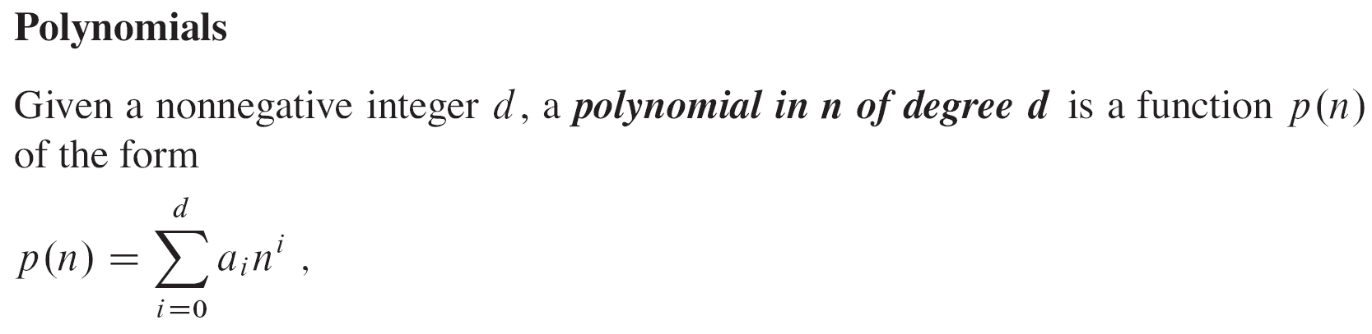
Measuring Growth of Algorithms: terminology

Slide 26
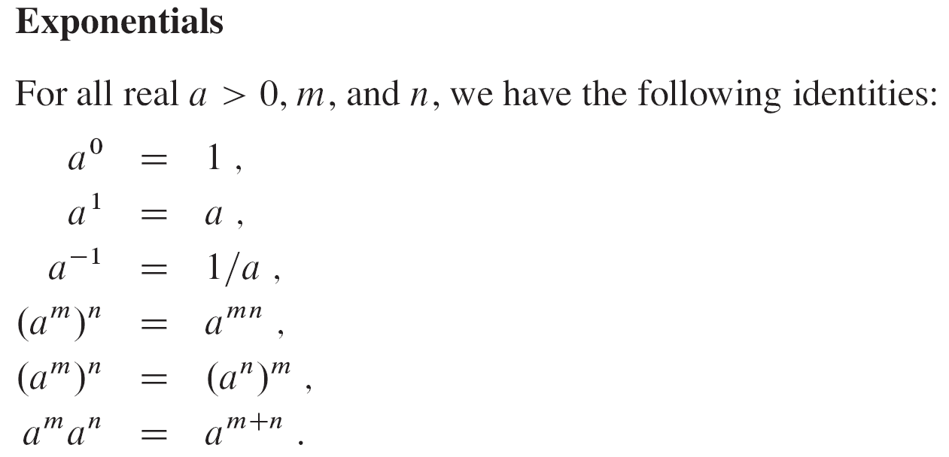
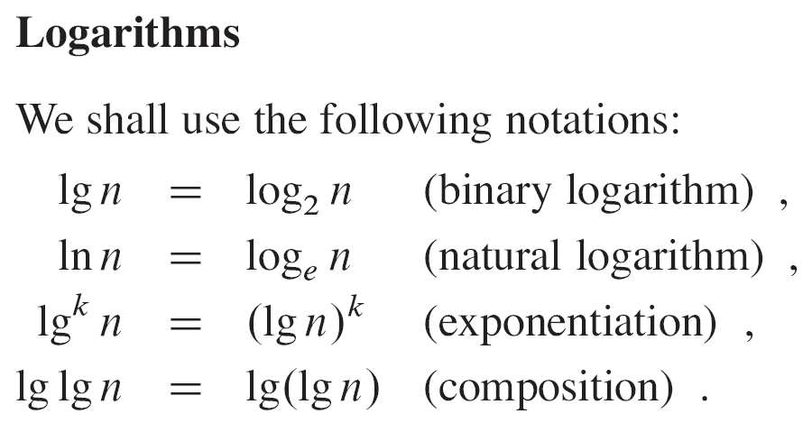
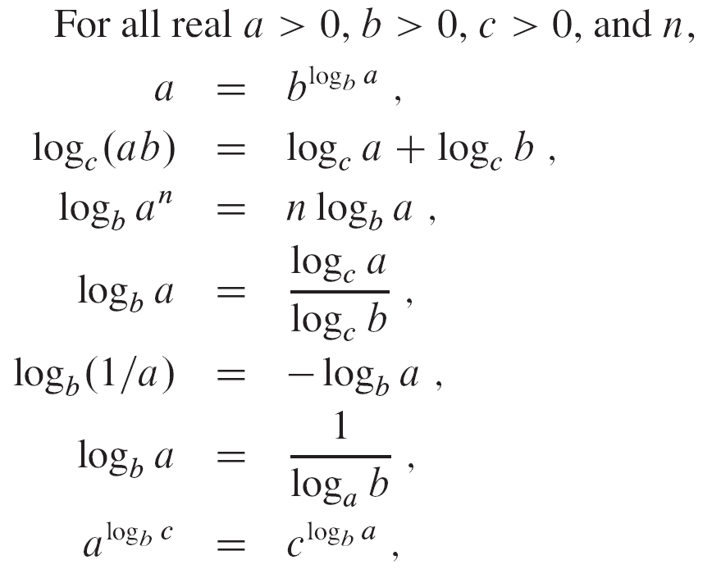
Measuring Growth of Algorithms: terminology

Slide 27
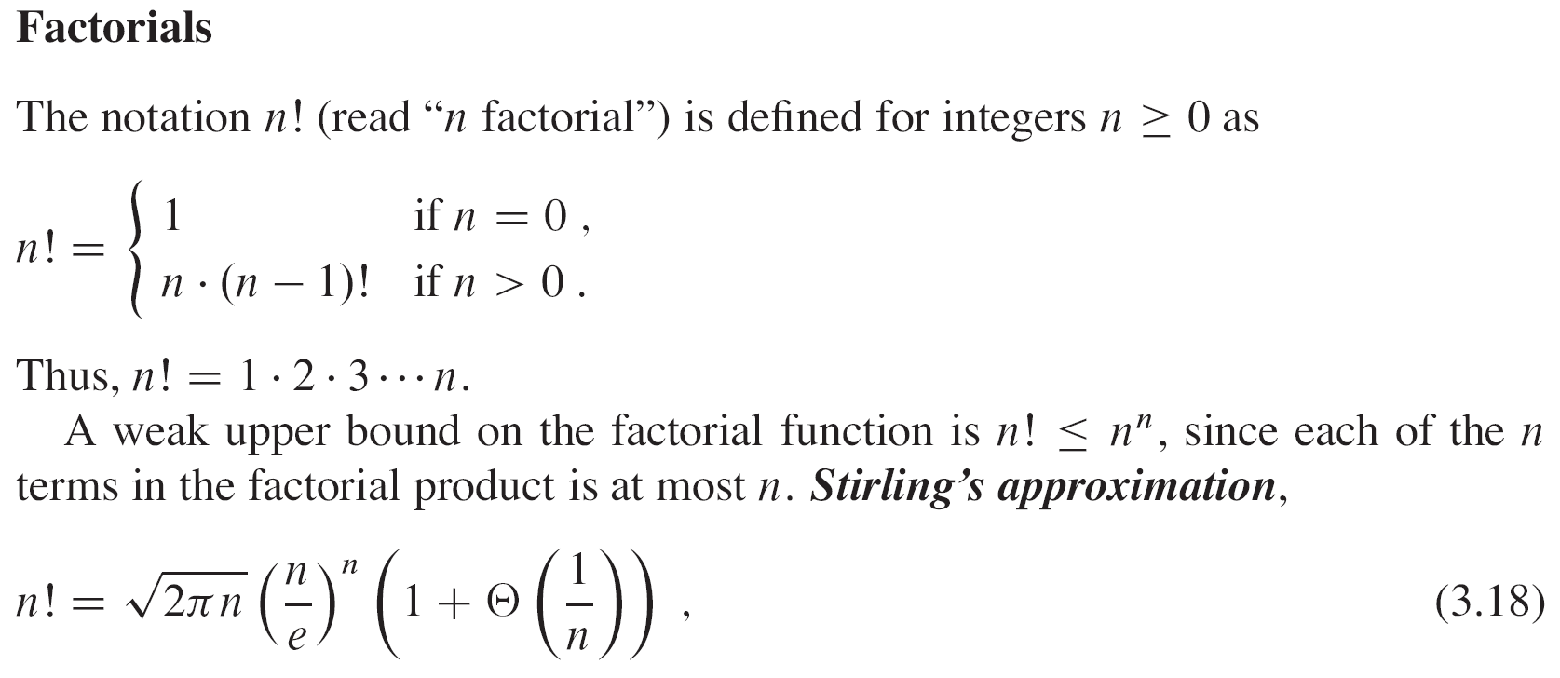
Measuring Growth of Algorithms: terminology

Slide 28
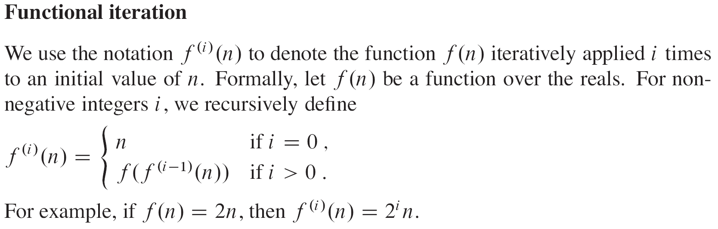
Measuring Growth of Algorithms: terminology

